Slide 1
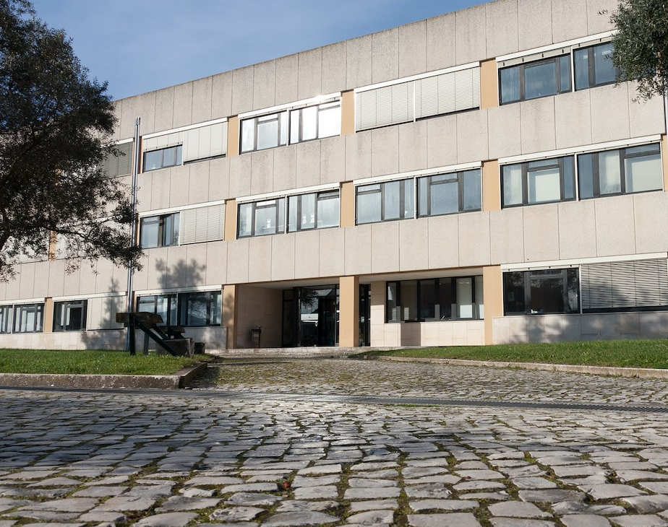





Unidade Curricular “Padrões e Desenho de Software” #09 – Structural Patterns (3)
António José Ribeiro Neves
an@ua.pt
https://www.ua.pt/pt/uc/12275

Slide 2

Outline
Flyweight Pattern
Presentations
Façade Pattern
Quiz
Proxy Pattern

Slide 3
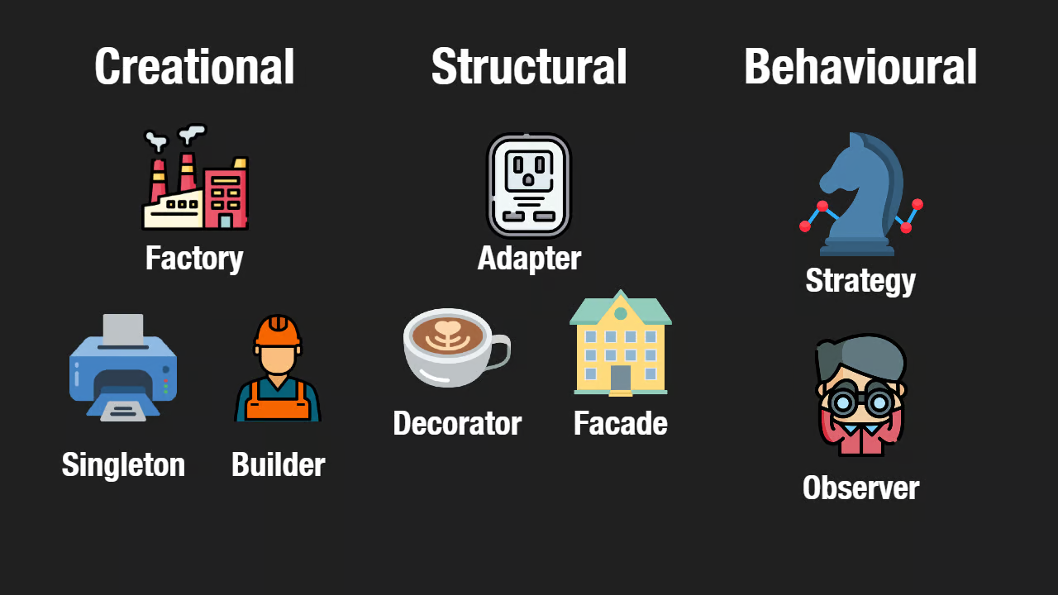
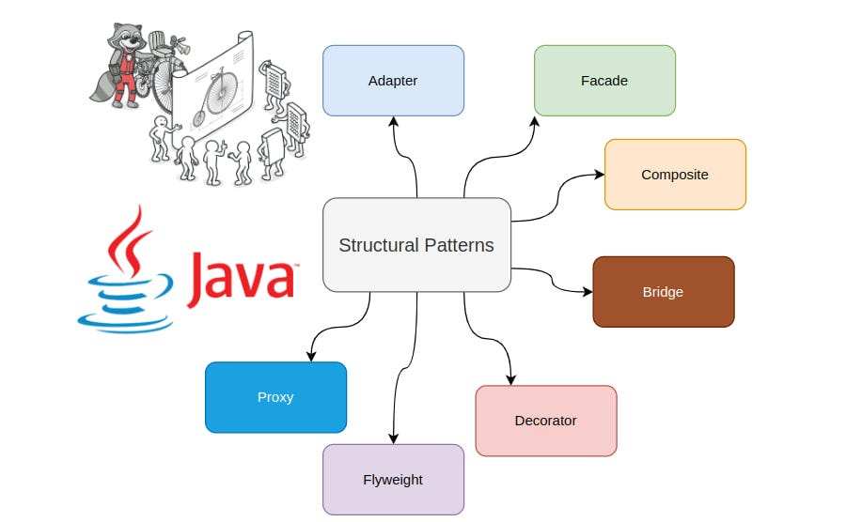
Structural Design Patterns
40 minutes to explore the Façade, Flyweight, and Proxy design patterns.
Join a group with at most 12 students. Elect the leader! She/He will present later the work.
This is a field work, You can go outside and find a comfortable place to discuss the topic.
You have 5 minutes to present your findings later – you can talk and use the white board.
Deliver the result in a physical paper!

Slide 4

Time for the colleagues ☺

